Slide 1
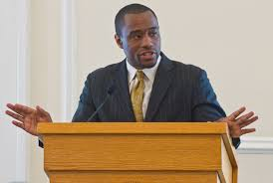

Elements of a Strategic Communications Plan

Slide 2

Objectives
1
3
Know main elements of a strategic communications plan
Be able to write a single overarching comm. outcome
2
4
Know types of plan outcomes/objectives, audiences, and material
Know the general structure of a message platform

Slide 3
An Introduction to Strategic Communications Planning
What it means and how to do it

Slide 4
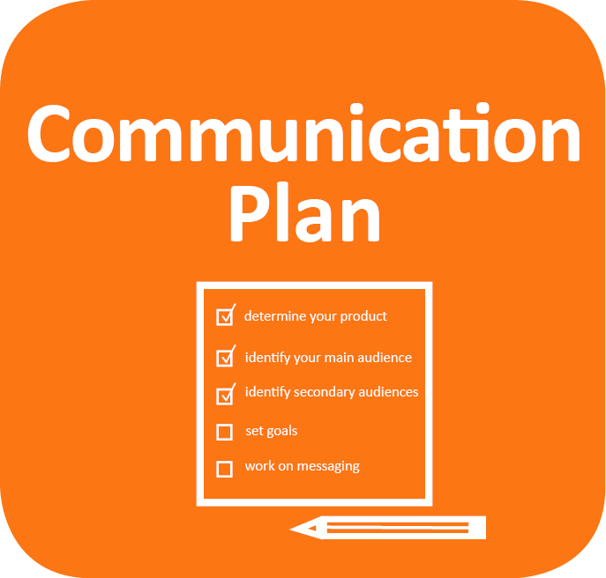
Strategic
Communications
Plan

Slide 5
Strategic
Communications
Plan
A concise statement that defines how an organization intends to advance an important goal through the delivery of information to critical external and internal stakeholders.

Slide 6

Elements of a Strategic Communications Plan
Outcomes/Outputs
Audiences
Messages
Materials
Implementation Plan
A strategic communications plan is a concise statement that defines how an organization intends to advance an important goal through the delivery of information to critical external and internal stakeholders.
?

Slide 7
Communications Objectives:
Outcomes & Outputs
What we hope to achieve

Slide 8



Generic Results of Communications Campaign
Results in audience
Outcomes
Outreach to
audience
Outputs

Slide 9
Audience Response 1:
Knows more
Awareness
Belief
Understanding
Outcomes

Slide 10
Audience Response 2:
Take action
Engagement
Decisions
Advocacy
Outcomes

Slide 11
Communications Outputs
# of activities
Examples
Briefings conducted
Presentations delivered
Stories published
size of audience
Examples
Legislators briefed
Readers of an article
Downloads of an online report
Outputs

Slide 12
Single Overarching
Communications Outcome (SOCO)
A SOCO is the outcome or change you want to see as a result of communicating. The SOCO is not your message.
World Health Organization
Setting Communications Objectives

Slide 13

Part I of a SOCO
The Set-Up
What is the Issue to be addressed?
What “new” info does the audience need to know (i.e., why does the issue need to be addressed now)?

Slide 14
Part II of a SOCO
The Desired Outcome
Who needs to change?
What is the change this target audience needs to make?

Slide 15
Structure of a SOCO (part II)
This communication effort will…
…[verb 1]…
what the effort will do
…[noun]…
to what people
…[verb 2].
So they do what

Slide 16
Suggested words for
SOCOs
Verb 1
Notify
Educate
Convince
Engage
Influence
Activate.
Noun
Public health executives
Politicians
Funders
Health workers
Journalists
General public.
Verb 2
Know
Understand
Believe
Approve
Change policy
Change behavior
This communication effort will…
…[verb 1]…
what the effort will do
…[noun]…
to what people
…[verb 2].
so they do what

Slide 17
Sample
SOCO (part II)
This communication effort will…
…convince…
what the effort will do
…doctors in public hospitals…
to what people
…to decrease the number of unspecified causes of death by 40 percent in next 2 years.
So they do what

Slide 18
“SMART” standards
Specific
Measurable
Assignable
Realistic
Time-limited

Slide 19
Sample
SOCO (part II)
This communication effort will…
…convince…
what the effort will do
…doctors in public hospitals…
to what people
…to decrease the number of unspecified causes of death by 40 percent in next 2 years.
So they do what

Slide 20
Audience Analysis
Who we are trying to reach (and what we know about them)

Slide 21

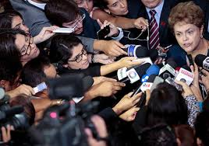

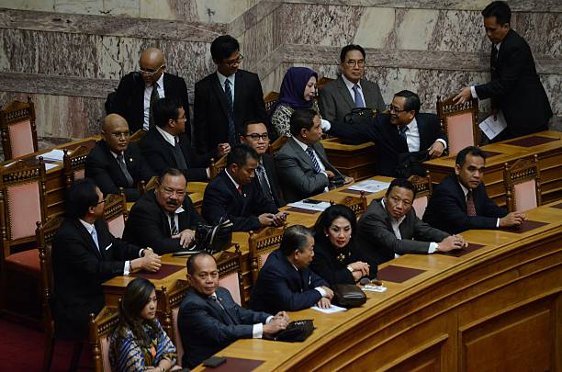

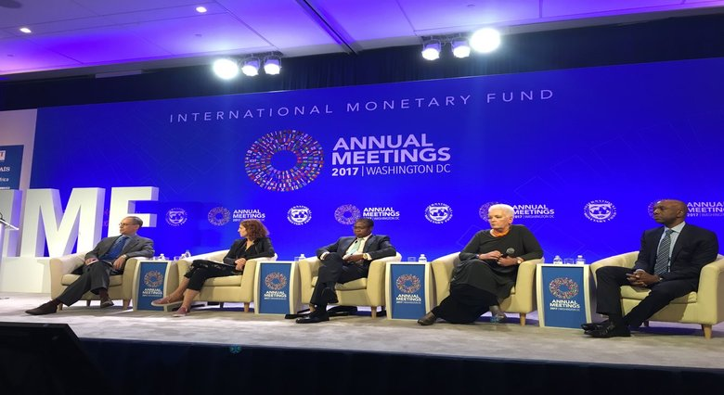
Common audiences for public health communications
Public health executive
Politicians
Funders
Health workers
Journalists
General public.

Slide 22
What information would you want to know about your audiences before trying to communicate with them?

Slide 23
How to “Map” Audiences
By Their Position
Do they agree or disagree with you?
By Their Interest
Are they invested or disengaged?
By Their Power
Are they influential or not?
By Their Knowledge
Are they experts on the issue or not?

Slide 24
Example:
2-Dimension Audience Analysis
Disengaged Invested
Blockers
Champions
Disagree Agree
Source:
World Health Organization,
Effective Communications Handbook
Avoiders
Silent
Boosters

Slide 25
Messages and Materials
What you want say to your audiences and how you will say it to them

Slide 26

History/
Lit. review
Methods
Statistical Analysis
Results
Typical sequence of messages in “expert” communication
Implications for Policy

Slide 27
Results
Statistical Analysis
Methods
History/
Lit. Review
Sequence typical “nonexpert” wants to hear messages
Implications for Policy

Slide 28

Message Types
Core Message
1 message audience should take away
Supporting Message
2-5 messages that make audience more likely to accept core message
Points of Evidence
1-4 data-driven facts audience will find compelling

Slide 29
Message Platform
Core Message
Supp. Message #1
Supp. Message #1
Supp. Message #1
Supp. Message #1
Fact
#1
Fact
#1
Fact
#1
Fact
#1
Fact
#1

Slide 30


Pitch
How would you deliver your messages in a short (2-minute) talk?

Slide 31

Presentation
What set of slides would you use to support a longer (10-15minute) talk?

Slide 32

Visualization
How would you present your key data-driven messages in charts and maps?

Slide 33
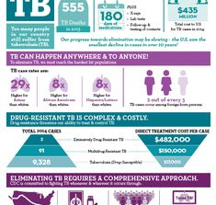
Infographic
How would you present your story in a series of visuals?

Slide 34
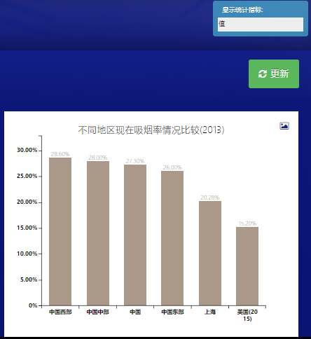
Data Access Portal
How would you make your provide access to and visualize your key data online?

Slide 35
Wrap-up

Slide 36

Elements of a Strategic Communications Plan
Outcomes/Objectives
Audiences
Messages
Materials
Implementation Plan
Monday

Slide 37
Elements of a Strategic Communications Plan
Outcomes/Objectives
Audiences
Messages
Materials
Implementation Plan
Tuesday
Pitch
Presentation

Slide 38
Elements of a Strategic Communications Plan
Outcomes/Objectives
Audiences
Messages
Materials
Implementation Plan
Thursday
Visualization
Infographic

Slide 39
Elements of a Strategic Communications Plan
Outcomes/Objectives
Audiences
Messages
Materials
Implementation Plan
Friday
Data Access Portal

Slide 40
Objectives
1
3
Know main elements of a strategic communications plan
Be able to write a single overarching comm. outcome
2
4
Know types of plan outcomes/objectives, audiences, and material
Know the general structure of a message platform

